Slide 1


Slide 2

INTRODUCTION
PURPOSE
KEY FEATURES
EXISTING SYSTEM
PROPOSED SYSTEM
MODULES
DESCRIPTION OF MODULES
DESIGN
SCREENS DESIGN
CONCLUSION

Slide 3

An individual report card of each student has to be displayed and printed at a keystroke according to any selected format.
An important aid for teachers and students to judge their performance. Merit list printing by totals for a class by individual subject marks for a class. Student performance in a particular subject or all the subjects must be expressed. Performance of teachers of various classes can be easily compared.

Slide 4
Purpose
The system displays the list of all issues that are open, closed, in progress. If the user can get registered by clicking on the logon button and provide the required information as specified. Each time the registered customer come on to the site he can makes use of the user name and the password that is allocated to him.

Slide 5

User configurable grading system.
User configurable examination pattern.
Examinations-weight age handling.
Calculated / Average Column handling.
Grace marks handling.
Special Analysis section.
Sub-subjects marks entry handling.

Slide 6

It is time consuming process as the user has to type the
dbase commands. He has to remember all the commands
which are difficult.
It is limited to a single system.
A user who wants only to have some information has to
contact the administrator every time.

Slide 7

User friendliness is provided in the application with various
controls.
The system makes the overall project management much
easier and flexible.
It can be accessed over the internet.
Vast amount of data can be stored.
There is no risk of data mismanagement at any level while the
project development is under process.
Relationship between the administrator, owner/developer and
subcontractor can be maintained very easily.
It provides high level of security using different protocols like https etc.

Slide 8

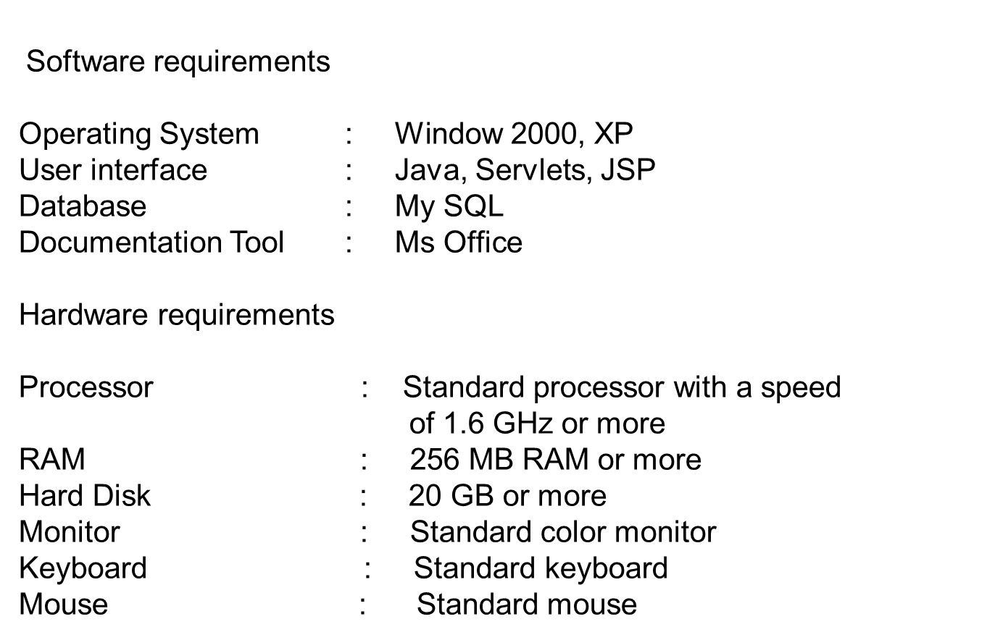

Slide 9

Admin Module
Staff Module
Student Module

Slide 10


Login
Admin Actions
  views personal details
  Update schedules
  view reports
  Updates attendance of students
Log out

Slide 11

Login
Staff Actions
  views personal details
  views attendance
  view results
Log out

Slide 12

Login
Student Actions
  views attendance
  views results
  View Schedules
Log out

Slide 13

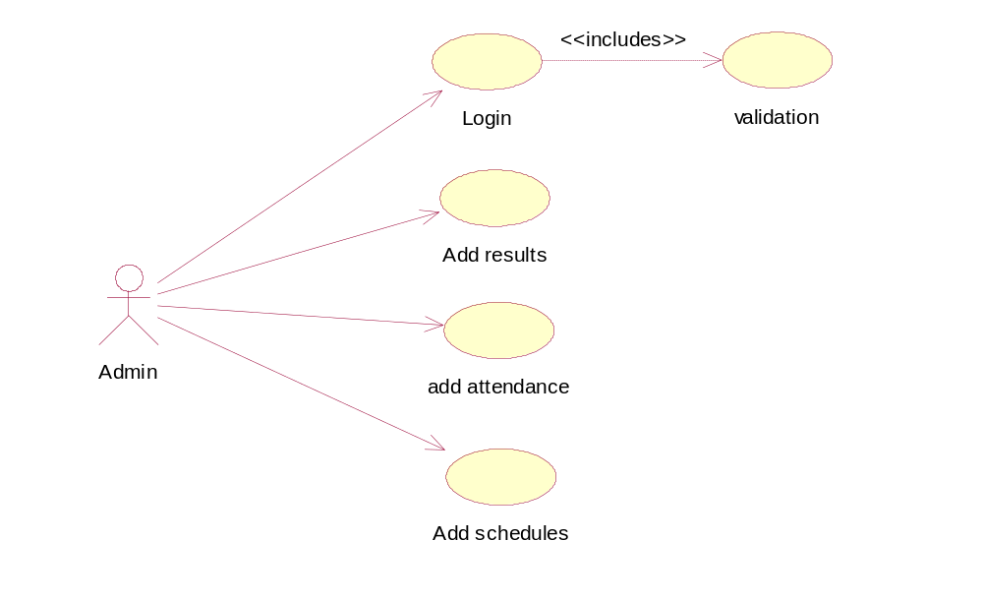
Use case diagram

Slide 14
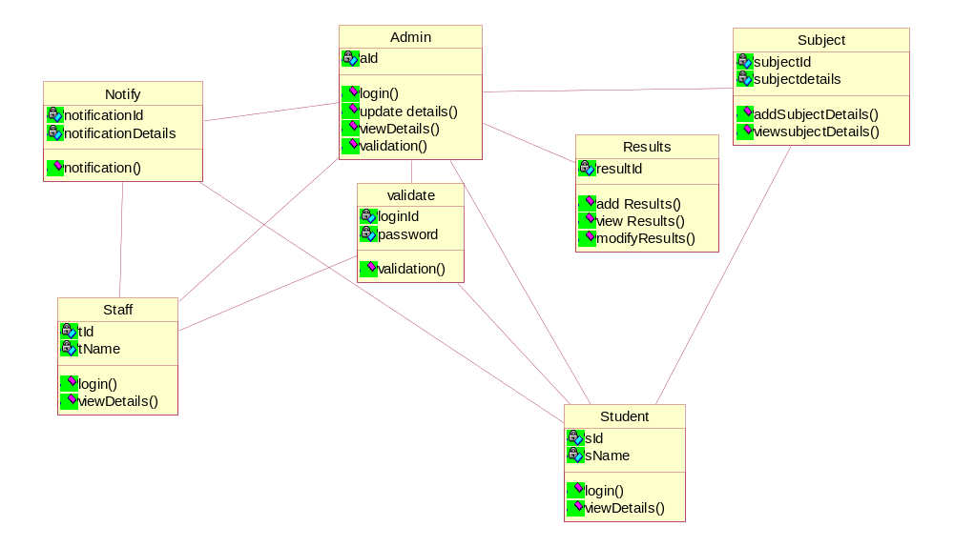
Class diagram

Slide 15
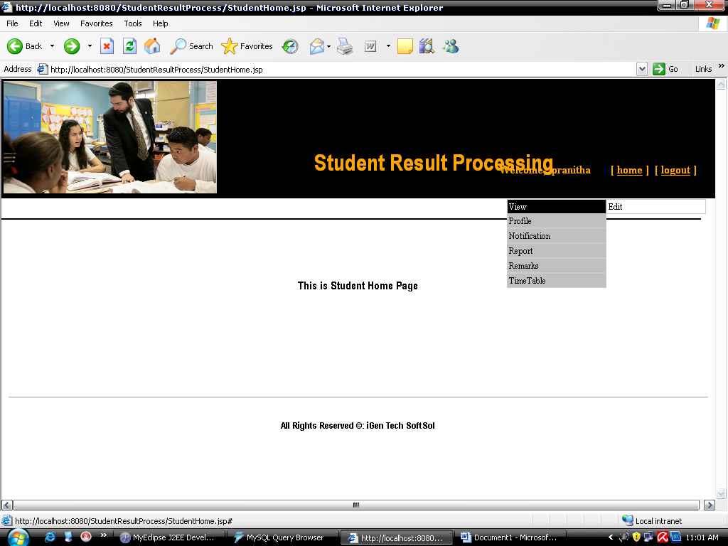
Student Page

Slide 16
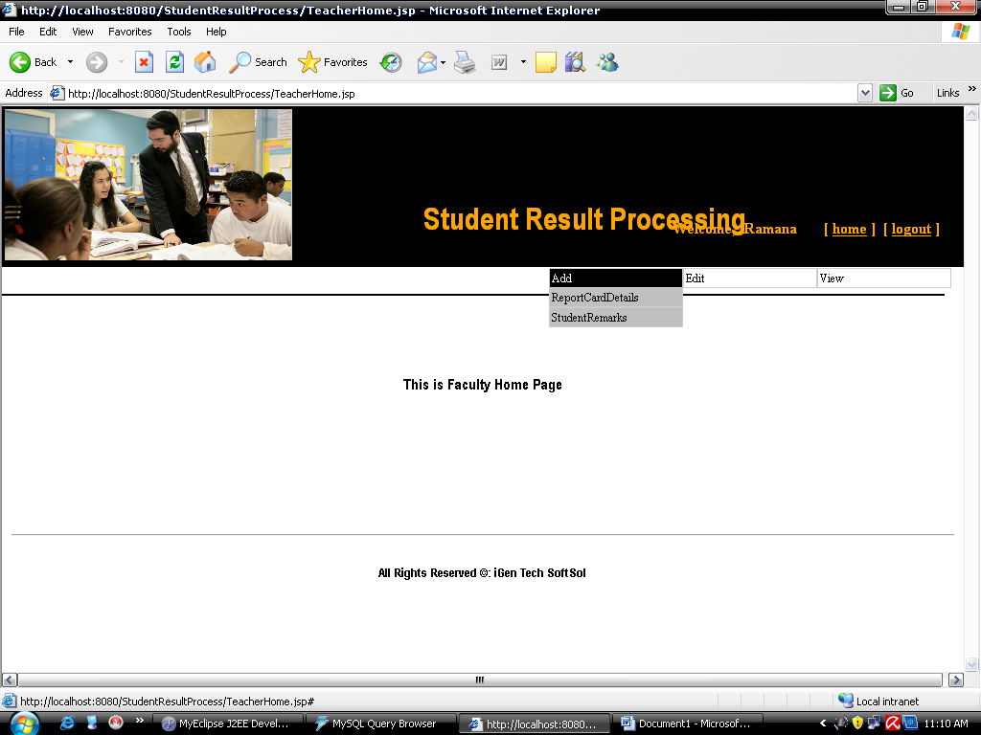
Faculty Page

Slide 17
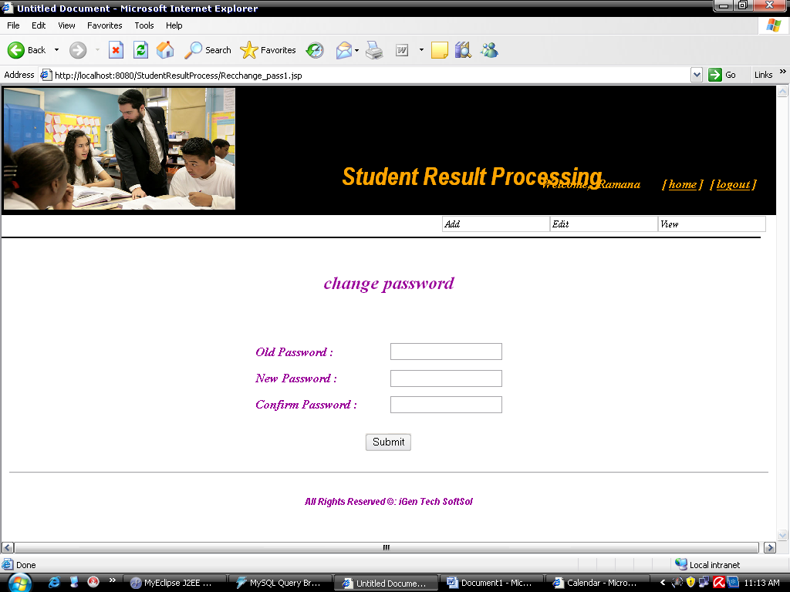
Change Password

Slide 18
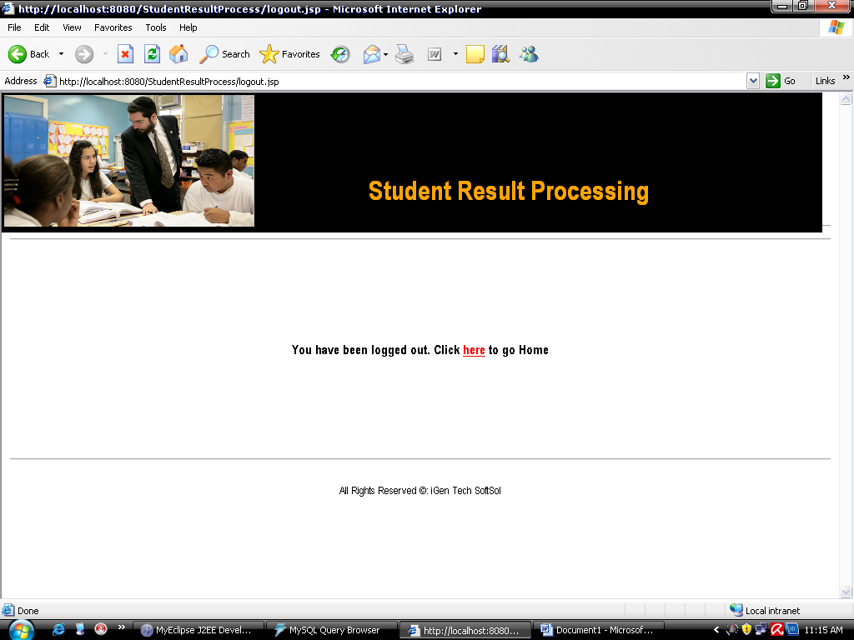
Logout Page

Slide 19

A proper analysis of positive points and constraints on the component, it can be safely concluded that the product is a highly efficient GUI based component. This application is working properly and meeting to all user requirements. This component can be easily plugged in many other systems.

